Slide 1
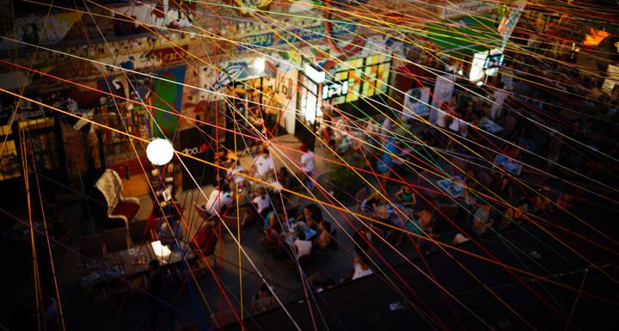
The only branded entertainment event in Romania
18 – 24 August 2014 | Fabrica Terrace| ADfel.ro
powered by
updates on: ADfel.ro

Slide 2
What is ADfel?
ADfel is the only branded entertainment event of România and the coolest playground of Romanian unconventional advertising, promoting alternative ways of brand expression and unconventional ways to reach consumers.
7 days each year: August 18 – 24, 18 PM – 1 AM 8 editions until now, since 2006 100+ smart brands so far
400+ ideas so far 7.000+ people come to be surprised, 500.000+ reach per brand per year 3.800.000+ reach for ADfel 2013 (ZeList)
See the best of ADfel 2013: case-studies [EN] | video [RO] | article [RO]

Slide 3
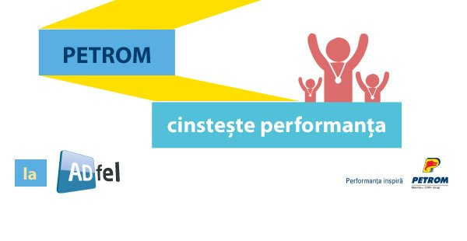
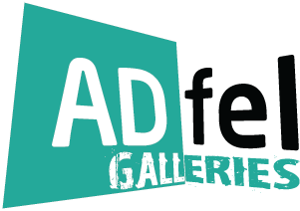
Activations at ADfel 2013
Click any of the links below to get to a particular brand case-study, in English:
PROIECȚIILE
or get the big picture of ADfel: case-studies [EN] | video [RO] | article [EN]

Slide 4
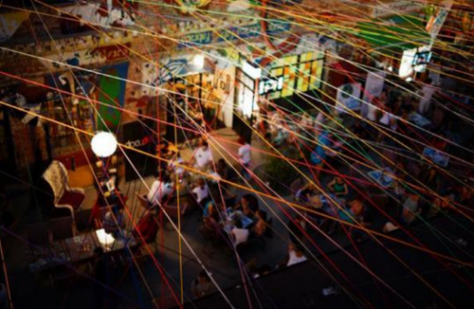
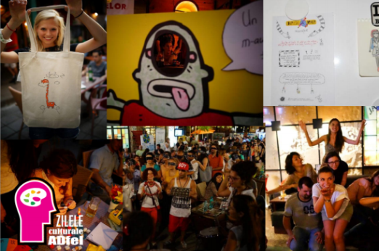
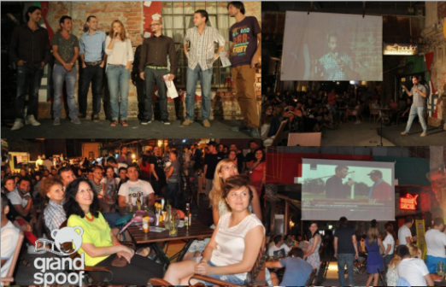
What happens at ADfel?
• happenings & unconventional activations Monday to Sunday, powered by the most important brands // see
• ADfel Galleries, Monday to Sunday, the exhibition of the best unconventional works worldwide // see
• Adfel Culture Days Monday to Wednesday, smart activations of NGOs // see
• Grand Spoof, Thursday, the big competition of ad parodies worldwide 3// see • creative competitions anytime, before and/or after the event // see
• themed TV ad screening, Monday to Sunday, after 10 PM

Slide 5
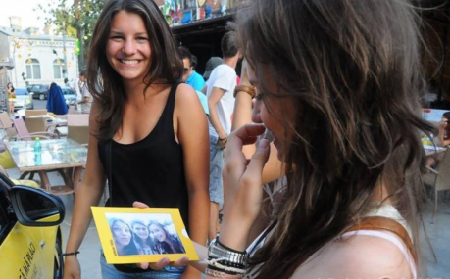
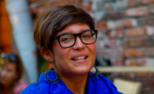
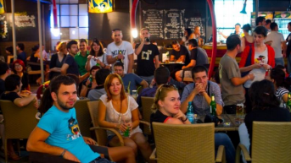
What is the target?
1. going-out people, who are loyal customers of interesting locals & places in Bucharest, and who are interested in advertising as entertainment • core: 18 – 30 y.o. / extended: 16 – 35 y.o. • socially active, urban, interested in cultural events • brand-aware, with a preference of a brand or another 2. people who see advertising as entertainment 3. people who work in marketing & communication • people from advertising agencies • event organisers • marketing & brand managers, etc.

Slide 6
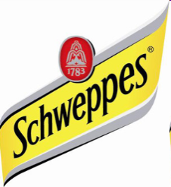
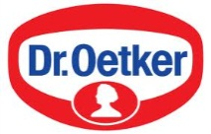
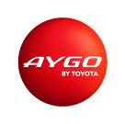
What brands came to ADfel? / selection
Câteva din brandurile participante până acum

Slide 7
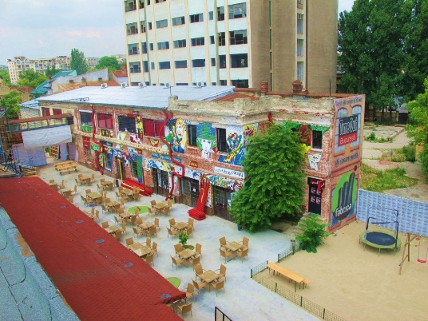
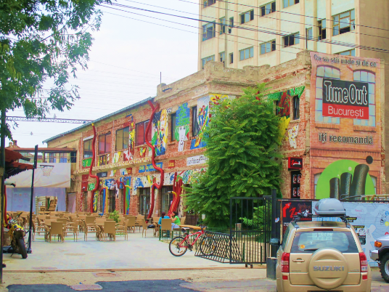
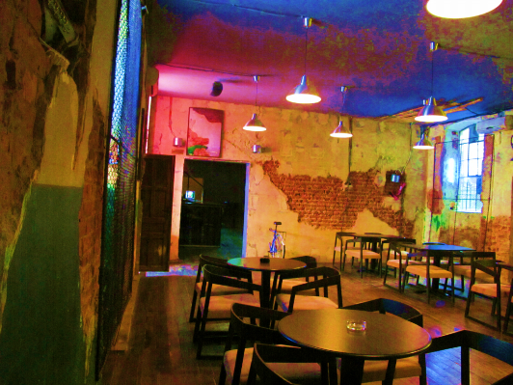
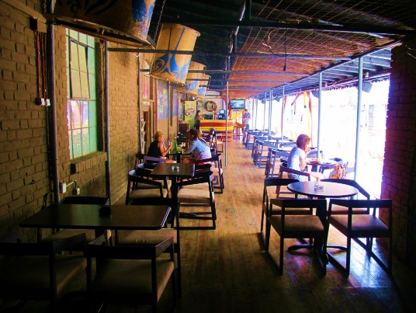
Where is ADfel held?
Fabrica Urban Lounge is a tiny city in the center of Bucharest, which features:
one of the largest open-air clubs, surrounded by shops
indoor pub
indoor club
indoor skatepark
indoor climbing facilities
children playgrounds
Address: 11 iunie 50 Landmark: near Unirii Square, 15 minute walking
Fabrica is open during ADfel: 12 AM – 1 PM, daily
Live happenings at ADfel: 6 PM – 12 PM, recommended
10 screens, 8 speakers, 4 microphones, 10 projectors, Wi-Fi

Slide 8
Why activate at ADfel?
For the brands: the place where the brand promises can be demonstrated, directly for 7.000 participants and a reach of 500.000 people
For the agencies: the place that gathers the smartest activations of Romania, consolidating brands, helping the creative business grow and driving motivation
For the consumers: the place where advertising is really cool (again)
For all:
The perfect context: an audience that comes to see brand ideas
Memorable activation: brand experience, smart execution, redoable after
Important amplification: dedicated media campaign, social media, PR, buzz

Slide 9
Dedicated brand promotion
BRAND
extrapromo on location (screens, MC)
content creation, good for use after the event
1 to 7 zile with brand activations at ADfel
(seen by up to 7.000 de participanți)
15 - 30 days of dedicated media campaign (campaign reach of up to 500.000)
amplification via ADfel general campaign
amplification via buzz, social networks
1 or several unconventional brand activations

Slide 10
How do I participate at ADfel?
The overall budget is comprised of 3 directions: ADfel fee + creative budget + implementation budget
1. The ADfel fee varies between 3.000 – 20.000 EUR, depending on: • the activation visibility at ADfel: number of activations & days of the brand at ADfel • the magnitude of the media campaign and connected activations, outside of ADfel It includes: • association with ADfel: acces to ADfel public & the reputation of the event • brand activation design and/or consulting for activations proposed by the agency • media campaign associated with the presence at the event : design & consulting • design and/or consulting for agency’s proposals • production and implementation • editorial campaign, PR, going viral • dedicated making-of + follow-up
2. Creation fee
3. Implementation fee

Slide 11
Dedicated media campaign for the brand at ADfel
The campaign detailed below is dedicated to the brand, created on your communication platform, announcing your presence at ADfel)
The dedicated campaign will be amplified via the general Adfgel campaign, that also features your brands on some particular channels
The media partners of ADfel 2014 are under final review, here’s a sample for 2013:

Slide 12
Dedicated media campaign for the brand at ADfel: details
Content: The dedicated media campaign for your brand has 2 layers:
overall promotion of the brand presence at ADfel (announces the brand presence at the event)
Individual promotion for each of your brand activation at ADfel (invites the public to participate at every activation during the event)
Magnitude: The campaign is proportional to the brand presence at ADfel (no. of days and of activations)
Timing: all the branded activities will b promoted simultaneously, 30 days (about 15 before the event + 15 days after the event)
Amplification: all the branded activities at ADfel can also be communicated via any other channels of the brand, of the agency or of other partners

Slide 13
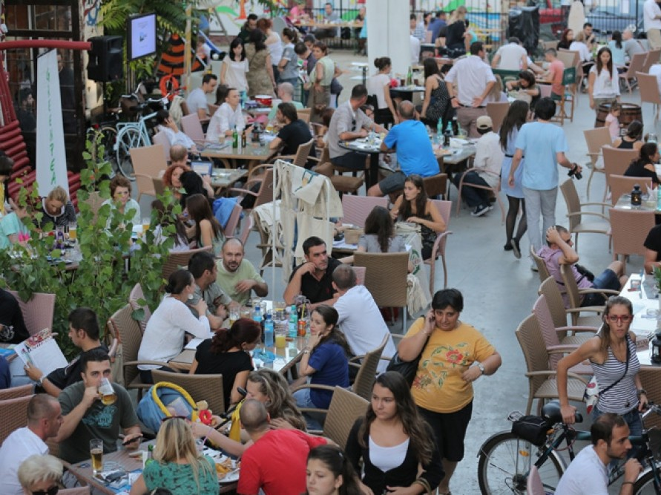
ADfel subevents
Notes:
13

Slide 14
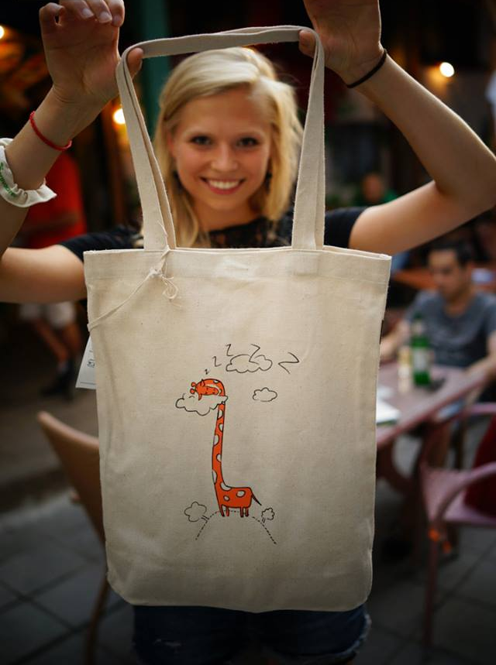
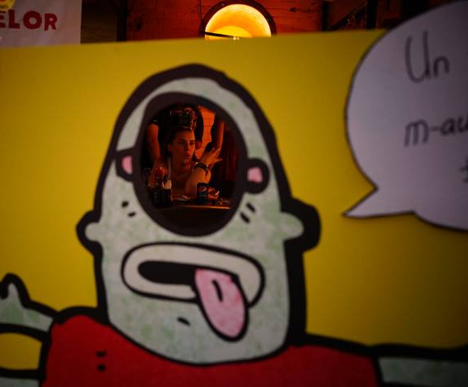
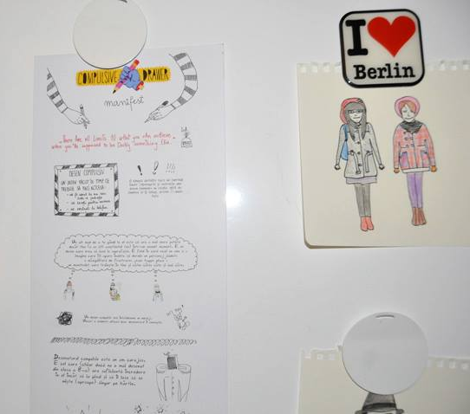
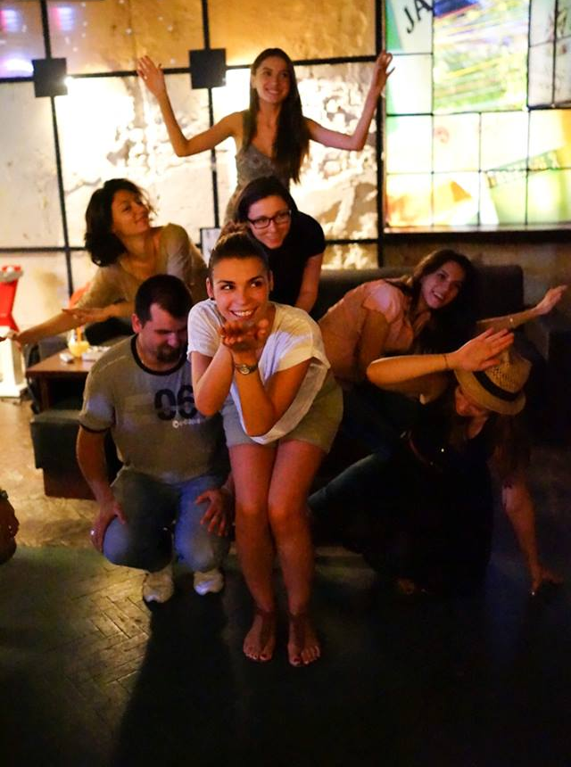
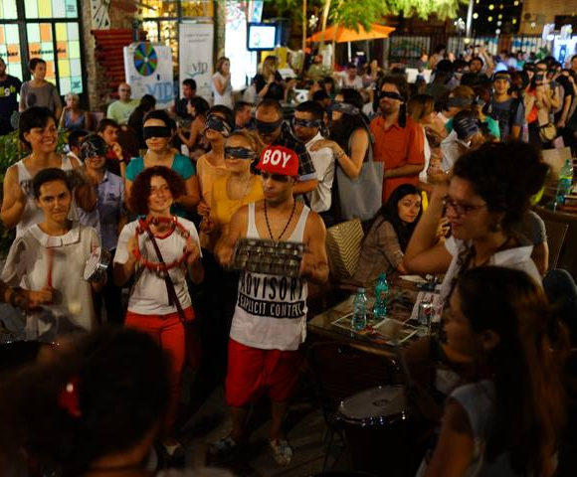
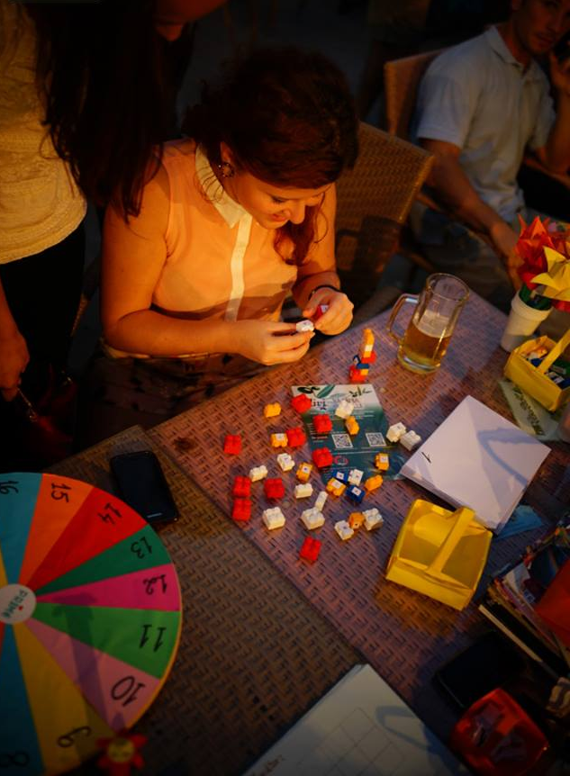
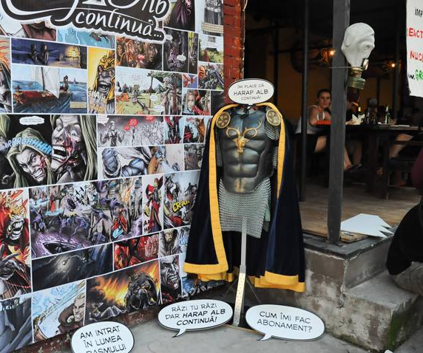
ADfel Culture Days are aimed at foundations, cultural institutes and NGOs which can thus promote their non-conventional initiatives without any participation cost. As many as 20 such organizations participated in 2013.
Notes:
14

Slide 15
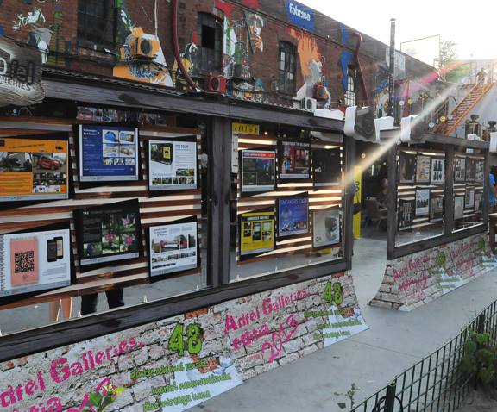
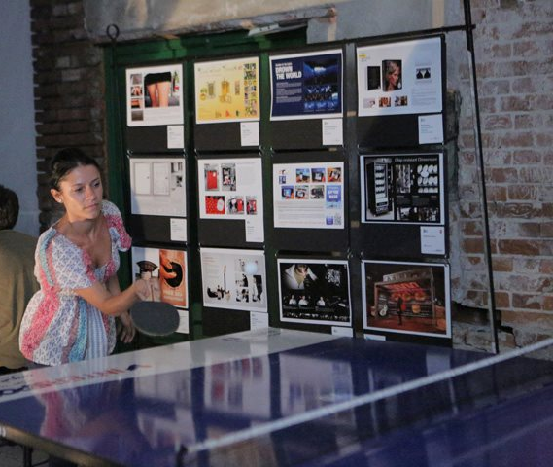
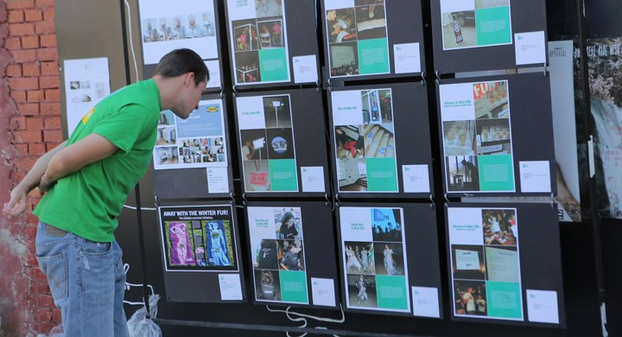
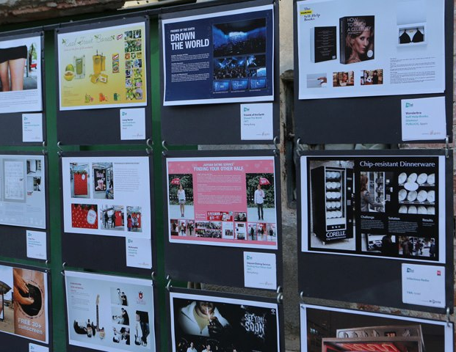
ADfel Galleries is the exhibition of Romanian and international non-conventional advertising works. Back in 2013, 70 international and 10 Romanian agencies displayed 250 such works, former award winners in 6 advertising festivals.

Slide 16
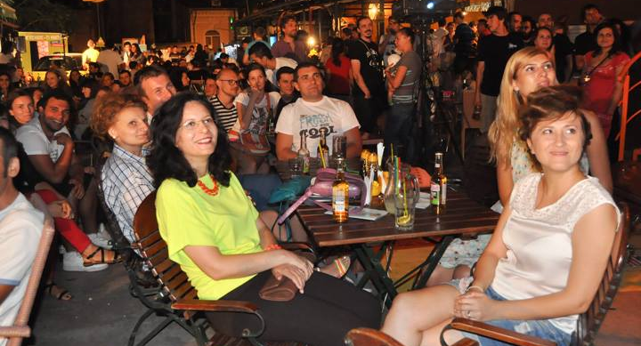
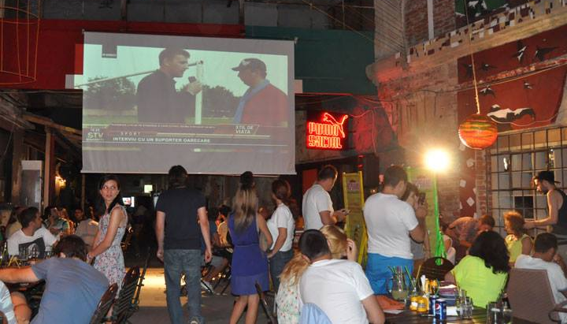
Grand Spoof is the largest Romanian contest of commercial burlesquing, held every year under the ADfel umbrella and presented by Ciuc Premium.
More than 300 spoofs were registered in the first seven editions (as many as 84 in 2013) and juried by creative directors from advertising agencies and on-line voters.
Jury award: Cahfu| Audience award: Gărgăriţă-Riţă | All 2013
Notes:
16

Slide 17
About the organisers: IQads
As early as 2003, IQads has been the most important platform which gathers together the community of advertising and creative industry lovers, either respected professionals of the industry or just admirers of the advertising phenomenon, while being the most read media product in Romanian dedicated to the communication industry.
the editorial department provides multimedia content every day: news, interviews, analyses, a.s.o.
the projects department develops a set of events/services dedicated to communication, such as ADfel, the Agencies Cup in Football, the Agencies Cup in Cooking, The Creator - the user generated content competition platform
audience: more than 100,000 unique visitors each month, 120,000 fans in the social media communities and 20,000 active newsletter subscribers
IQads is a mark of Blue Idea. Blue Idea portfolio includes also SMARK, the community of the Romanian marketing professionals (www.smark.ro)

