Slide 1
powered by
an event by
The only karaoke and show competition for marcomm people in Romania
23 – 25 September 2014 | CupaAgentiilor.ro/Karaoke

Slide 2
Don’t imagine a Saturday night in a smoky karaoke bar.

Slide 3
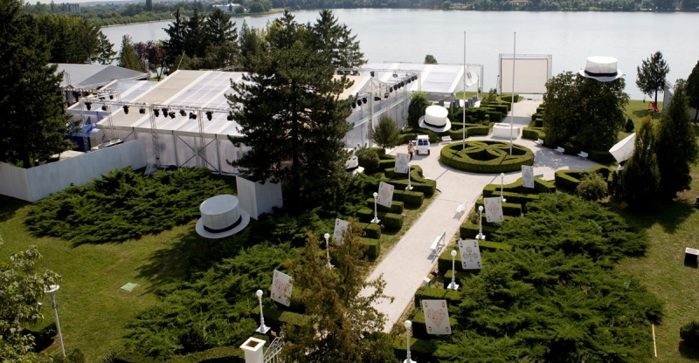
Imagine 3 days, 10+ music stars and one big stage where advertising people perform and sing, in duets with stars, accompanied by a live band and with fans screaming out loud in the audience.
Participants: 500+ people in advertising. Reach: 500,000+ people watching the Cup and its brands

Slide 4
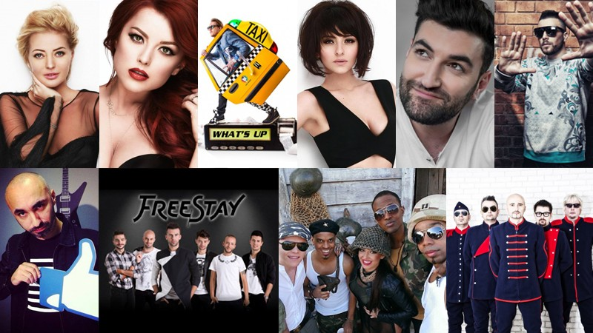
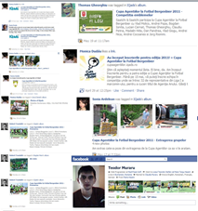
The Big Show
1 big stage
500 participants + fans
10+ music stars by Cat Music
media campaign & activations
creative competitions
buzz & big egos

Slide 5
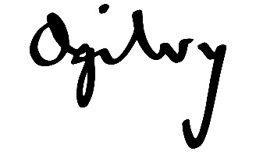
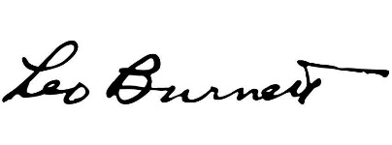
Since 2007, we have been organizing exclusive Cups for marcomm people. In 2014, we will compete in Football, Cooking, Karaoke and Gaming. This is why all major agencies close down for a few days every year…

Slide 6
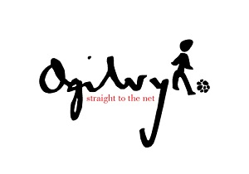
…and turn into the most creative football clubs, kitchen teams, bands and gaming squads
See all Cups teams

Slide 7
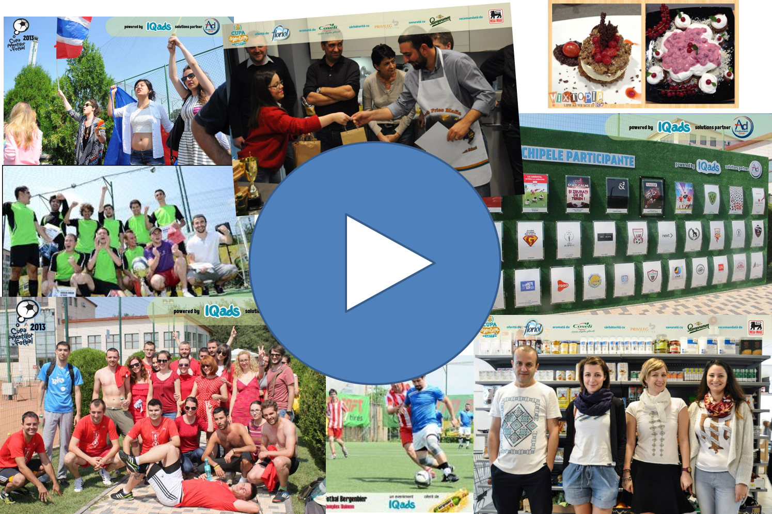
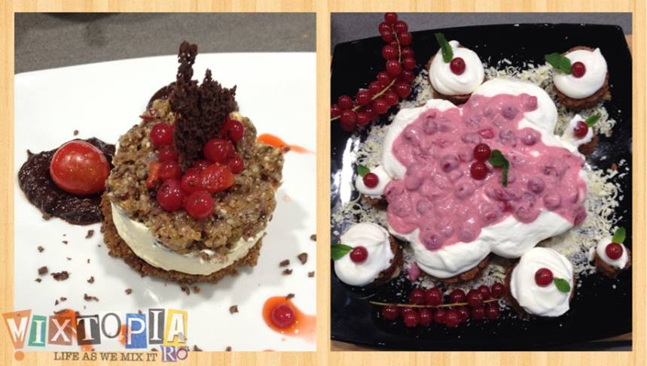
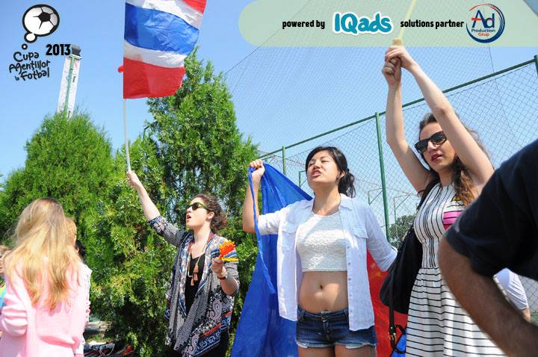
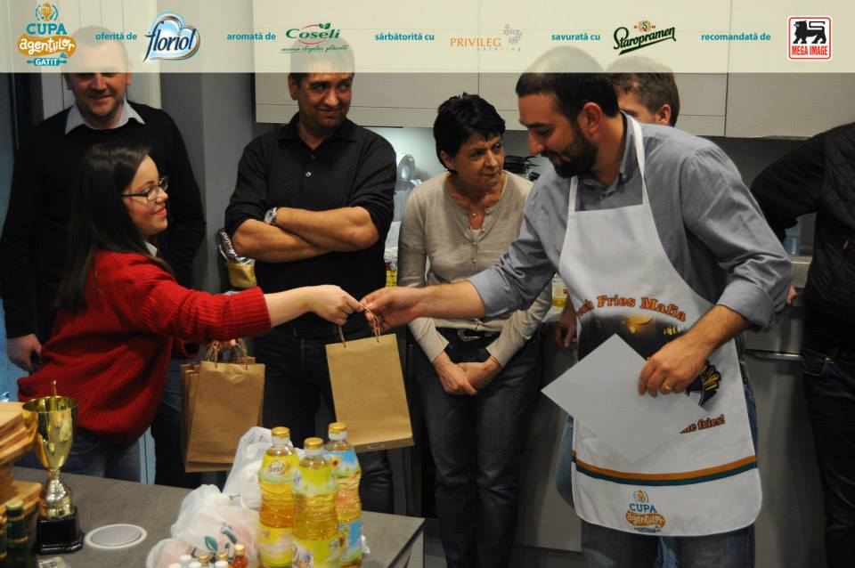
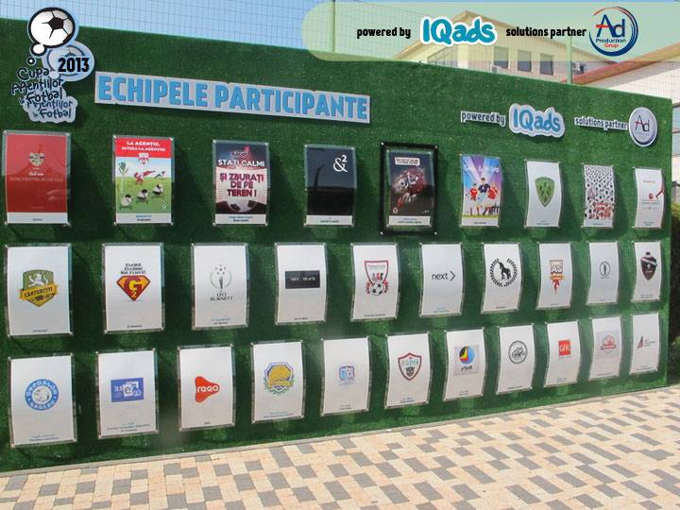
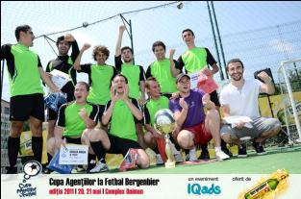
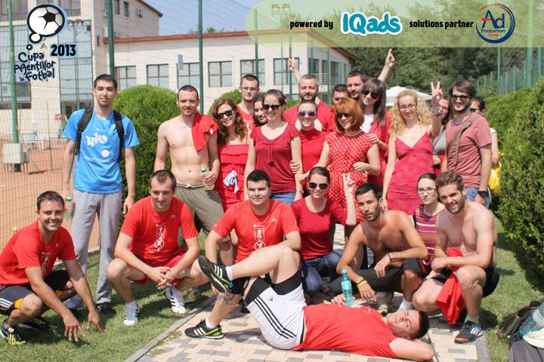
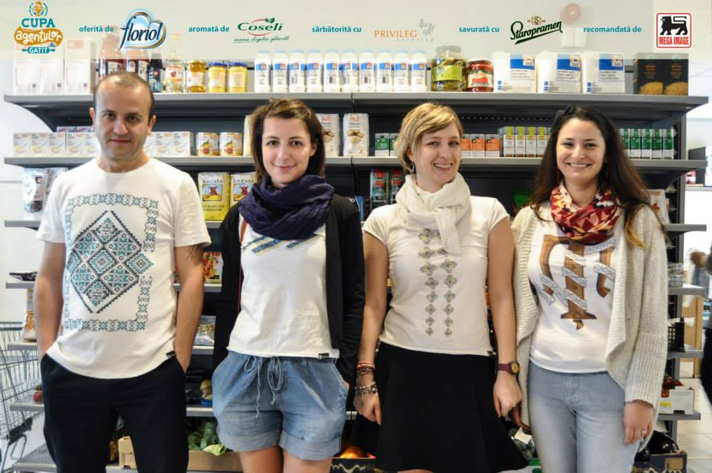
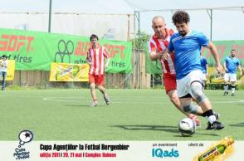
See what Cups are like
See football in 5 minutes
See cooking in 5 minutes

Slide 8
Brand promotion: overview
powered by
10 weeks of campaign
3 days of event
500+ participants
brand reach
500.000+ people
dedicated campaign (online, radio, print)
editorial campaign (articles, PR)
creative competition
- buzz, viralization, social networks
branding, sampling, activations

Slide 9
Brand opportunities
Online & offline association with an unique event, now at its first edition: The Agencies Cup in Karaoke
Excellent B2B reach of the brand to the entire advertising industry, 500 top professionals in marcomm in a single event
Good B2C visibility with the most creative community in Romania: 500.000+ people that will see the brand associated to the Cup
Branding throughout the media campaign associated to the event, 10 weeks adapted to brand communication: online, print, radio, PR, editorial
Activations, demos and branding during, before and after the event: pre-event: branded creative competitions during the event: activations and stunts, Cups and special prizes, prizes for the participants post-event: follow-up opportunities
Notes:
9

Slide 10
Association coordinates: overview
Partnership with a unique event: The Agencies Cup in Karaoke
Overall timing (event + communication campaign): 10 weeks, 15 July – 3 October 2014
Registration of participants: 15 July – 15 August
The Agencies Cup in Karaoke: 23 – 25 September (Tuesday, Wednesday and Thursday, 18:00 – 00:00)
Follow-up: 26 September – 3 October
32 teams, 2-10 players/team
First 2 days: qualification rounds
The third day: the finals + the awards ceremony
+ (optional) Online creative competition, dedicated to the brand
Notes:
10

Slide 11
About the event
The Agencies Cup in Karaoke in 5 attributes:
First time ever. On its first edition, the Cup is the only event that offers a single stage to karaoke lovers in agencies
Accessibility. We have self-chosen playlists and required playlists, in order to stimulate participation - maniacs, enthusiasts and beginners + their supporters are welcome
Prestige. People in marcomm who love karaoke are now able to take their pleasure to the next level, from a closed group competition to a competition involving the entire industry, on the same stage
Fun. The cup and the activities around it will make it interesting to watch, both for those that are directly involved (participants and supporters), and for those watching from a distance (fans and by-standers). At the same time, the Cup is an unconventional form of team building for agencies and a show for the enthusiasts
Endorsement. An annual event, the Cup will quickly become a traditional event reuniting people in the industry, organized by a recognized voice in advertising: IQads

Slide 12
Who is interested in the Cup
Agencies, as business for their brands and self-promo: it creates activations, a clever demo and creative competitions for a spectacular audience
Brands, as business: B2B and B2C promotions for the most important creative community in Romania, which amplifies and retransmits the brand message
The audience: participants and audience, people in marcomm, for fun: as a different kind of team building and creative class skipping with the industry, personal ego and agency fight

Slide 13
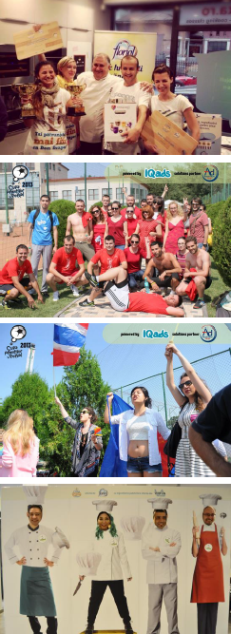
Case studies
[The Agencies Cup in Cooking 2014] Floriol as naming sponsor concept and implementation by Floriol Naming sponsor founder (the same as in 2013), Floriol created a high profile event for advertising people, supported from the first edition See the making of Floriol, 4 min.: http://www.iqads.ro/podcast/1083
[The Agencies Cup in Karaoke 2014] Cat Music as naming sponsor concept and implementation by IQads & Cat Music Naming sponsor founder, Cat Music brings along their artists in duet with the agencies, to promote B2B their artist management and music licensing services
[The Agencies Cup in Cooking 2013] Verla as production partner concept and implementation by IQads Verla (importer of production materials) reached for the first time the advertising agencies in 2013 offering its materials as creative supports for advertising people, in 11 points of contact See the making of Verla, 4 min.: http://www.iqads.ro/podcast/980
4. [The Agencies Cup in Football 2013] AdProduction as solutions partner concept and implementation by IQads AdProduction integrated its materials in the CAF and organized a creative competition proving they are production tailors See the making of AdProduction, 4 min.:
http://www.iqads.ro/podcast/870
Notes:
13

Slide 14
Activities of the Cup: overview
The Cup includes activities and sponsorship activities for 10 weeks, of which the 3 days event is the central point:
Identity building for agencies: name + logo (online, pre-event)
Creative competitions for brands, associated to the Cup (online, pre-event)
Partners activations in agencies (offline, pre-event)
Actual karaoke competition (3 days: 23 – 25 September, location TBD)
Partners activations in agencies (offline, post event)

Slide 15
Activities of the Cup: competition
Each agency can sign up singers or bands: our estimate is 30 agencies x 2 - 10 representatives + 200 supporters
Each agency representative is entitled to 3 performances on stage, each for up to 5 minutes: - one self chosen song, solo or with a band - one song from the portfolio of Cat Music, solo or with a band - one song in duet with a Cat Music star and/or with the Cat Music live band
Each team will have to build an identity: name and logo
The stage performance of each team shall be voted by a professional jury (advertising, music, showbiz), with scores from 1 to 10
Logistics: staging, catering, hostesses, cups, award ceremony

Slide 16
Activities of the Cup: brands
Extensive opportunities for brand activations, online and offline
Possible starters (customized per request for each brand):
On-site branding: in the room, on stage, on site, etc.
Pre-event activations:
Creative competitions for brands, related to the brand and competition profile
Partners’ activations in agencies
Event activations:
VIP Area / Smoking Lounge / Interview Area
The show preparation area: makeup, hair styling, massage
Product demos: products, services, in dedicated areas
Official car
Live transmission partner
The unmusical room
Lip-syncing competition
Brand representative in the jury
Special awards, invented according to the brand profile
Post-event activations:
Prizes sent to agencies
Partners’ activations in agencies

Slide 17
The Cup Audience
Professionals working in the marcomm industry in Romania (advertising, media, PR agencies, marketing departments, etc.) and who were in contact with karaoke before, directly or through acquaintances
The karaoke experience level is variable, but everybody will find activities to make them follow the information online or participate in the Cup offline
As job level, we attract owners, top managers and executives (who also join the competition as a team building organized by them for the team), but also juniors and interns.
Maniacs: the most experienced, with dedicated equipment in the agency and/or participating in traditional meetings with other karaoke lovers, in the city clubs, have skills, their own playlist and put on a show, are a strong community, sing well, come for their ego
Enthusiasts: the ones who sang before, have some favourite songs, sing more for fun, they come along with the maniacs or to see what their talents rank against their competition
Newbies: the ones for whom karaoke is more of an experience they want to try, have sang before when they were younger or at parties, got a taste for it, are more relaxed when singing and join the competition rather for socialization and fun
Supporters, fans, other curious people in agencies: they come along with the other 3 categories or to support their colleagues (in the agency or in the industry)

Slide 18
The Cup Awards
On the third day of the Cup, an award ceremony will be organized, where competitors will receive prizes and diplomas
7 awards:
The top three ranked: Agency of the Year in Karaoke, 2nd place, 3rd place
The most spectacular duet with a Cat Music star
The most spectacular performance with the Cat Music band
The most spectacular freestyle performance
The fieriest gallery
Several special prizes offered by the brand, such as:
The most creative performance
The most popular performance
The best team message/poster

Slide 19
The Budget
The budget includes:
Partnership with the event
The concept of brand activities and/or consultancy for the activities proposed by the agency
Media campaign associated to the event: creation and implementation (10 weeks, online, radio, print)
Editorial, PR campaign, viralization
Making of + follow-up
The budget is proportional to:
The number of activations in the event
The number of days in which the brand is visible at the event (1-3)
The magnitude of activations
The magnitude of the media campaign
The budget does not include:
The implementation of event activations
Notes:
19

Slide 20
Online creation competition dedicated to the brand, integrated in the Cup (optional)
To increase the visibility of the brand’s involvement in the Agencies Cup in Karaoke and creatively activate participants in the Cup, the brand can also initiate a creative competition, associated to the event
The competition takes place based on a brief provided by the brand, activating participants in the Cup, the works being then propagated online and included in the offline event, as a method of increasing the overall visibility of the project
Possible brief / starter: create a poster to support advertising people in the Agencies Cup in Karaoke; the posters will be then produced, promoted online and brought on site, to stimulate participants.

Slide 21
Steps of the creative competition (optional)
Overall duration of these steps (competition + promotion): 15 July - 17 September 2014, online
Step 1. Signing-up
Publication of the brief provided by the brand, intensive promotion of the competition theme, publication of the accepted works from among the works submitted in the competition
Duration: 4 weeks, 15 July – 15 August (optimized for design competitions)
Step 2. Voting
Two juries:
The professional jury, consisting in representatives of the brand and IQads 60% of the final score
The public jury, voting online, on TheCreator platform, increasing the buzz and viralization of the competition 40% of the final score
Duration: 6 weeks, 15 July – 1 September

Slide 22
Pre-Cup promotion / part 1
Branding banners campaign, 500,000 views IQads.ro, SMARK.ro, 24FUN.ro, Realitatea.net, Money.ro, other media partners in the music industry
The IQads community Newsletter to the IQads community (20,000+ active members): - 2 x branded header in the IQads editorial newsletter - mention of the sponsor in other editorial newsletters
The IQads events calendar Inclusion of the signing-up period (text, poster, multimedia);
PR on submissions: news posted on IQads.ro, press releases pushed on other relevant media
PRE-EVENT
EVENT
FOLLOW-UP

Slide 23
Pre-Cup promotion / part 2
Direct communication to the IQads community and agencies (3.000 +) branded e-mails including the schedule
Branding of participant materials: Program, automatic computation of rankings etc.
Posting the draw
Badges and messages of all registered teams, promoted on social media
Name and posters of registered teams, promoted as we receive them
Tagging on Facebook of all participants, buzz on social media
PRE-EVENT
EVENT
FOLLOW-UP

Slide 24
Pre-Cup promotion / part 3
Print 24-FUN: 2 layouts x ½ page, branded message including the invitation to the cup
Branding on CupaAgentiilor.ro/Karaoke
Social media: updates on social networks, 130,000+ IQads fans and followers + partner social media accounts (Fan Page IQads, Fan Page IQads News, Twitter IQads)
Multimedia materials about the 2014 edition: teams and participants, prognostics
PRE-EVENT
EVENT
FOLLOW-UP

Slide 25
The Event
Agencies Cup in Karaoke, supported by the brand
Date: 23 – 25 September 2014 Place: tbd
Marcomm people who signed up, their supporters and fans come to the Cup to challenge each other.
PRE-EVENT
EVENT
FOLLOW-UP

Slide 26
Event promotion / part 1
On-site branding for the brand
Branding on the competition materials
Updates and pictures presented during the competition, tagging singers, published on social networks in a branded layout
PRE-EVENT
EVENT
FOLLOW-UP

Slide 27
Event promotion / part 2
Logo on all award diplomas
offering special prizes, on the brand’s platform, for example:
The most creative performer (singer/band member)
The most popular singer
The best team message and/or logo
Special prizes offered by the brand
PRE-EVENT
EVENT
FOLLOW-UP

Slide 28
Post event promotion
Branding banners campaign, 100,000 views thanking participants and congratulations to the Cup winners IQads.ro, SMARK.ro, 24FUN.ro, Realitatea.net, Money.ro
The IQads community Newsletter to the IQads community (20,000+ active members) mention of the results in the editorial newsletter
PR for the Cup winners: press releases and news published on IQads.ro
Updates on social networks, tagging of cup photos, including all participants, 130.000+ fans and followers of IQads (Fan Page IQads, Fan Page IQads News, Twitter IQads)
Making Of the Agencies Cup in Karaoke + the brand: promoted on IQads + Facebook
PRE-EVENT
EVENT
FOLLOW-UP

Slide 29
Cumulative branded reach, associated to the event
Via dedicated media campaign:
Location: over 500 participants
Online: 650,000 people (via 1,000,000 banner views, newsletters, branding)
Print: 100,000 people (via 2 layouts, 24-FUN Buc., 70,000 copies)
Via buzz, viralization, social networks, propagation of creative ads submitted in the competition:
Buzz: 150,000 people (participant generated promotion) + PR, news
------------------
800,000 people, less a 25% cross ratio:
Total branded reach of brand promotion in association with the event: 500,000 people, less crosses, in a 10 weeks promotion campaign

Slide 30
About IQads
The most important Romanian product fully dedicated to advertising, marketing and mass-media, a platform bringing together the community of communication enthusiasts - either respected professionals or mere karaoke lovers
IQads offers daily updated multimedia content: news, interviews, reviews & others and develops a series of events such as: ADfel, the Agencies Cup in Football, the Agencies Cup in Cooking, the Agencies Cup in Karaoke and the Agencies Cup in Gaming
Audience: more than 100,000 unique visitors each month, 110,000 members of the community in social media and 20,000 active subscribers to the newsletter
Notes:
30

Slide 31
brand campaign online offline activations sampling
agencies marcomm creation strategy
mics lights stage emotion
fans posters team emblems stars
prestige ego vanity team building networking
competitive spirit glory
visuals hostesses
The Agencies Cup in Karaoke. Ready to start?

Slide 32
Let’s talk at:
Marin Preda Business Developer Blue Idea Marin@IQads.ro +40 727 842 813
Adriana Jescu
Business Developer Blue Idea
Adriana@IQads.ro
+40 749 058 306
Notes:
32

