Slide 1
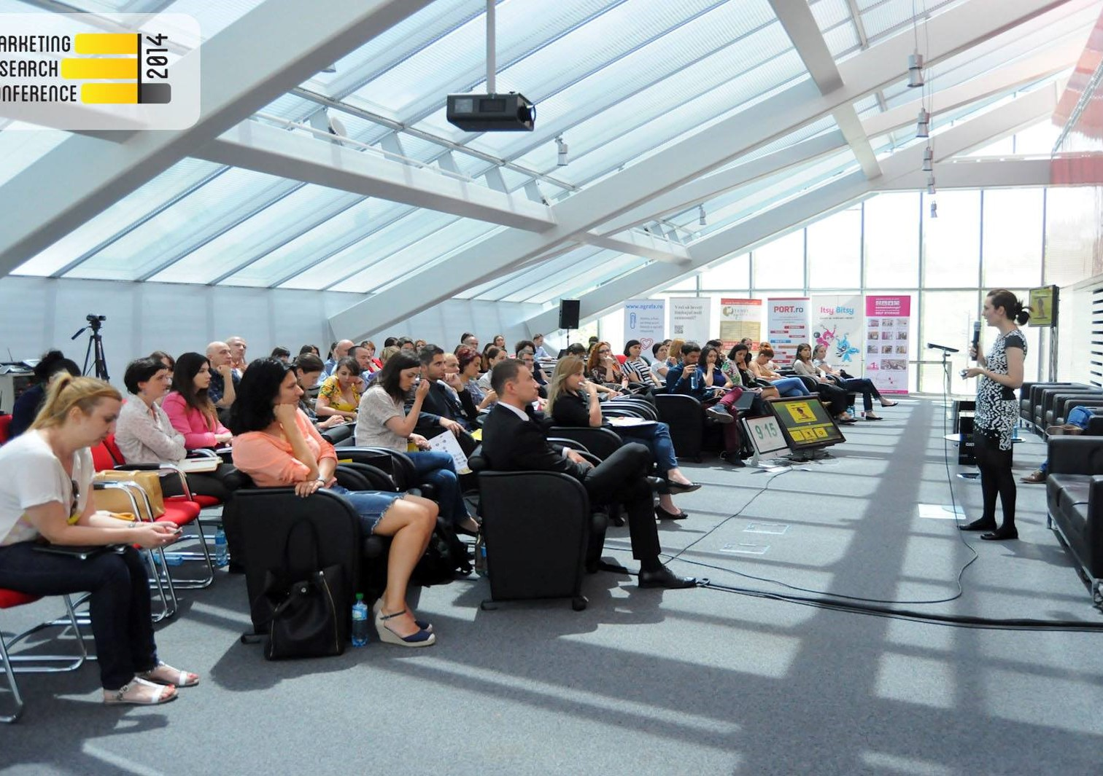
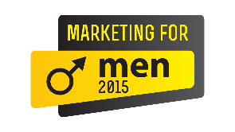
Smart promotion opportunities at SMARK KnowHow 2015
18, 19 February
13, 14 May
23, 24 September
11, 12, 13 November

Slide 2
Hello
We are tired of roll-ups.
We sleep during boring presentations.
We detest sales speeches sold as relevant information.
You hate them, too.
That’s why we should do business.

Slide 3
Why we do our conferences differently
We follow a simple principle: know-how during the sessions, smart promo between the sessions.
This helps us keep the sessions relevant, interesting and not paid so sponsors can deliver a great experience to a motivated audience, in the breaks:
demos, interactions, networking.
This makes SMARK KnowHow a unique hub of returning professionals, giving relevant brands the context and ways to get quality interactions with professionals hard to reach elsewhere: online, fairs, generic conferences.
29 events so far

Slide 4
What you get: main benefits
Awareness promote your brand in association with our conferences, to a precisely focused business audience: marketing, advertising, production
Interaction demonstrate your tools and make personal introductions to executives in the room, who wouldn’t otherwise try your product or visit your showroom
Reputation present your knowhow endorsed by the event’s topic, inform and engage an audience willing to listen
Leads easily boost your new business efforts, get information for all participants, close deals

Slide 5
What to do: suggested activities
Media campaign promote your brand via editorial and promotional materials - integrated campaign: online, newsletters, print, radio, social media / 250.000+ reach - editorial coverage on IQads & SMARK: interviews, feature articles and multimedia / 10+ per event - press coverage, controlled and extra: PR, press releases, journalists & bloggers invited - extra: dedicated advertorial for your brand Example: follow-up presentation for a partner: Promotions Now 2014 + Ad Production
Demos facilitate trials of your product or solution, related to the event: - before the event: custom training for the speakers / custom invitation for prospect clients - during the event: mini showroom / interactive booth / branded area / food & drink - after the event: networking lunch / digital presentation sent to all participants
Presentation 15-minute keynote about your knowhow on the topic: tools, case studies, interactive presentation (not promotional blah blah, but useful, on topic knowledge)
Workshop 2-hour session with a smaller group of the conference participants Example: Spoon held a workshop about wearable technologies at Brands & Communities 2014

Slide 6
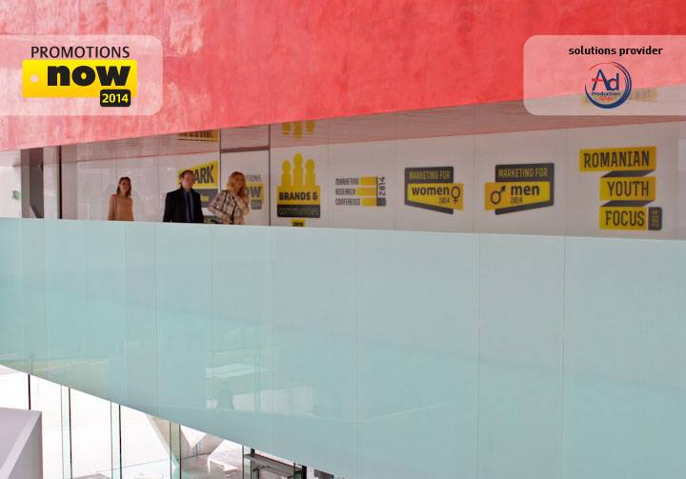
2015
Details about the events

Slide 7
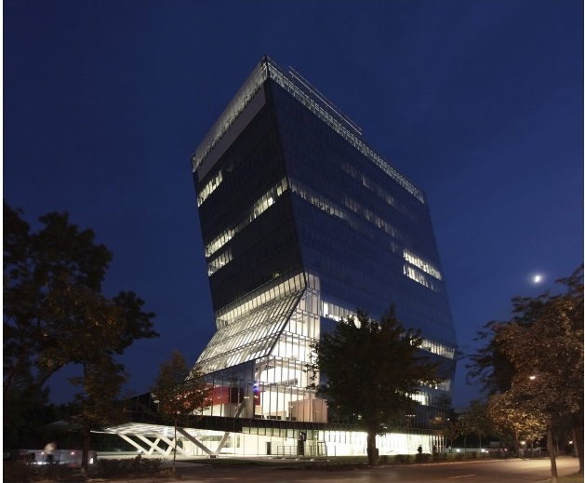
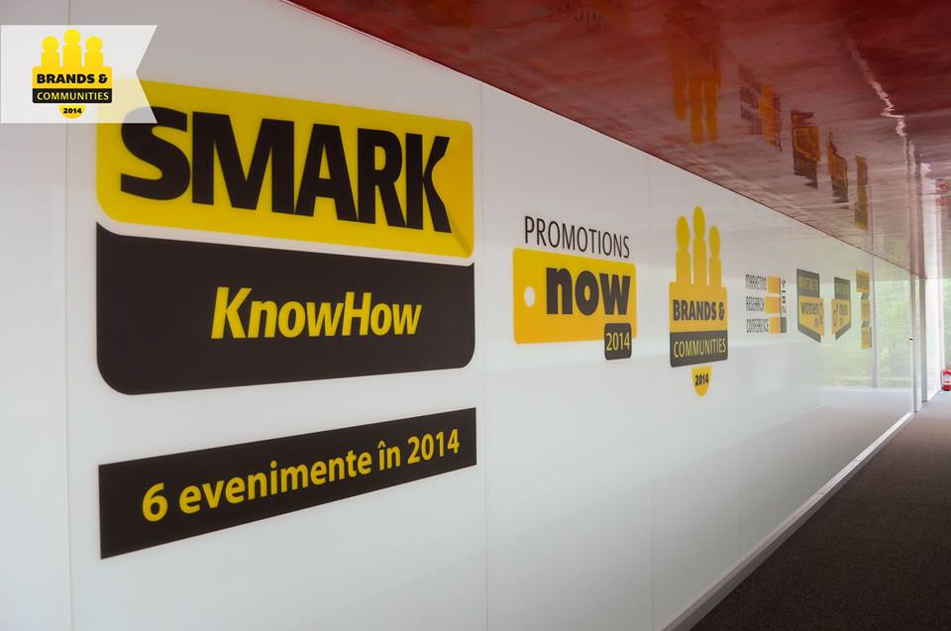
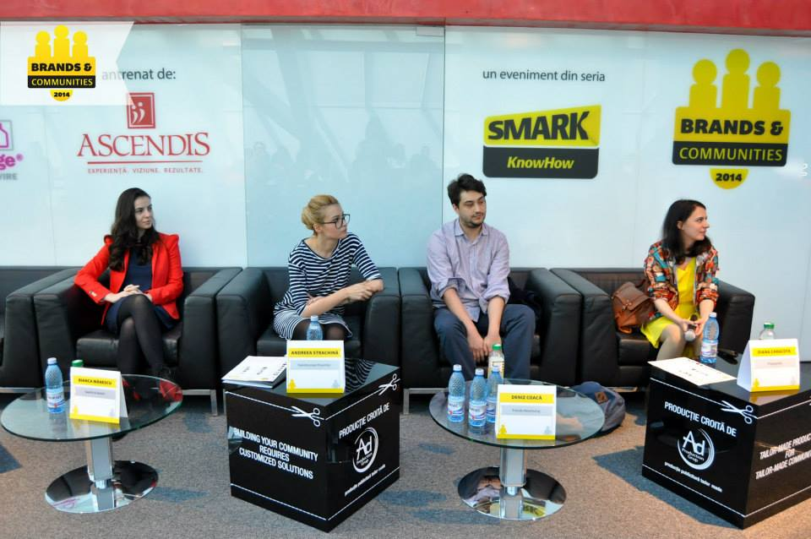
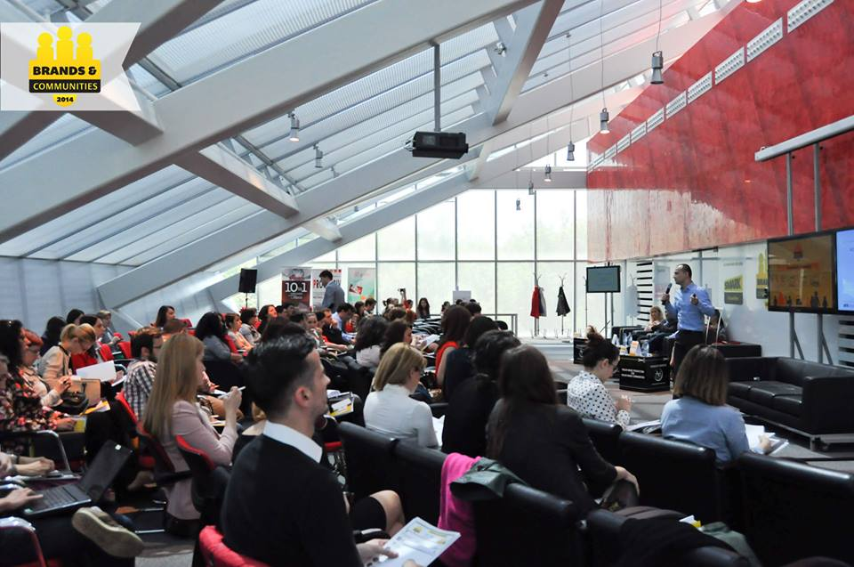
Event location
UniCredit Tower, Bulevardul Expozitiei, Nr. 1F (near Romexpo) a smart and ecological building, filled with natural light, green elements and art & cultural areas.

Slide 8
Event target
See all events here: www.knowhow.SMARK.ro
Direct participants: 150 non-duplicate participants per event
Clients, 40%: brand managers, marketing managers, managing directors, entrepreneurs
Agencies / ATL, 30%: creatives, planners, account managers, media people, online
Research, 10%: agencies and specialized marketing people
Production / BTL, 5%: BTL & events, production & implementation
Others: consultants, journalists, people interested in new ideas
Extended reach: 250.000 people reached per event:
Pre- and post-event campaign
The most important community of creative people & the community of marketing specialists – reached by the content we generate on IQads and SMARK about each event
A more general urban target – reached through our media partners
Speakers: staying to see the rest of the event
spectacular creatives, insightful marketing managers and key implementation pros, rock star sociologists, top planners & researchers educate and inspire on a topic

Slide 9
Event structure
presentations: 2 days x 4 hours per event
workshops: 2 days x 2 hours per event
speakers: 20 per event
A source of knowledge, inspiration and networking
Extended range of content: from hard data to inspiring stories
Highly customized and integrated event, from food to content
A well balanced mix of awesome speakers, newest data, most relevant best practices
Full of opportunities to give brands and agencies a credible and tangible positioning
Example:
Download the the speakers’ presentations from Brands&Communities 2014: day 1, day 2

Slide 10
Event content
Pros from very varied backgrounds come at the event, presenting and interacting:
THE BIG PICTURE: psychologists, sociologists
RESEARCH:
qualitative, quantitative
BRAND: marketing people
STRATEGY: planners, client service
CREATIVITY: creative people, content providers
IMPLEMENT: solutions

Slide 11
Great Speakers + Workshops / international examples
Ben Armistead
Global Planning Dir.,
Wieden + Kennedy Amsterdam
Claire O’Connor
Senior Research Consultant, Discovery Networks
Marina Clement
Behavioural Director
#ogilvychange
Ben Grossman
Senior Strategist,
Jack Morton Worldwide

Slide 12
2015
Sponsorship opportunities

Slide 13
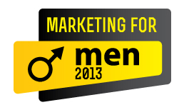
Examples: brands & associations
coaching by storage by data strategists flavored by
data strategists activated by trust providers
youth expert promotionals by
protected by men specialist leathered by
Other partner agencies

Slide 14
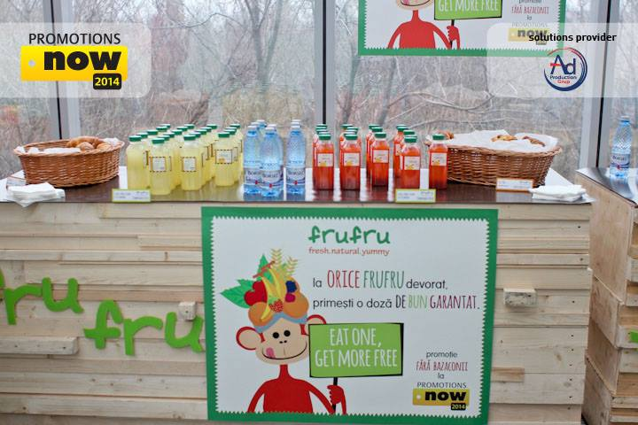
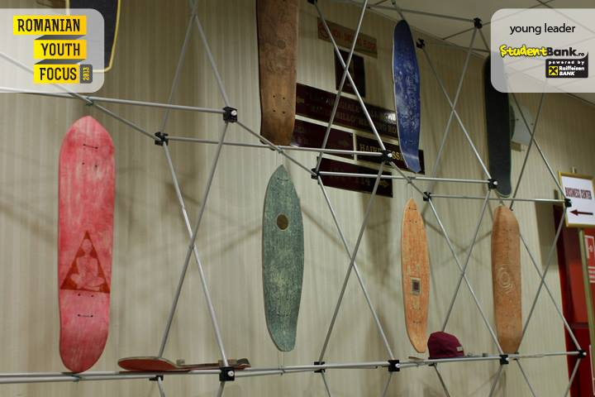
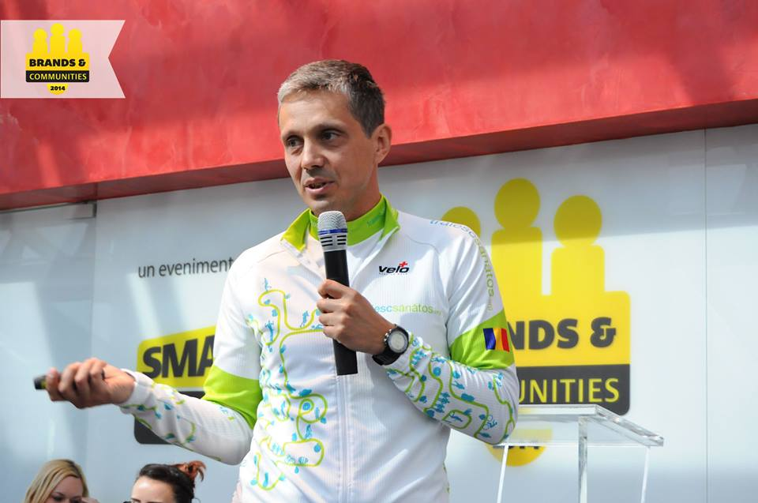
Examples: brands & activities
Each event is custom built: from topics, to speakers, to food, to extra activities

Slide 15
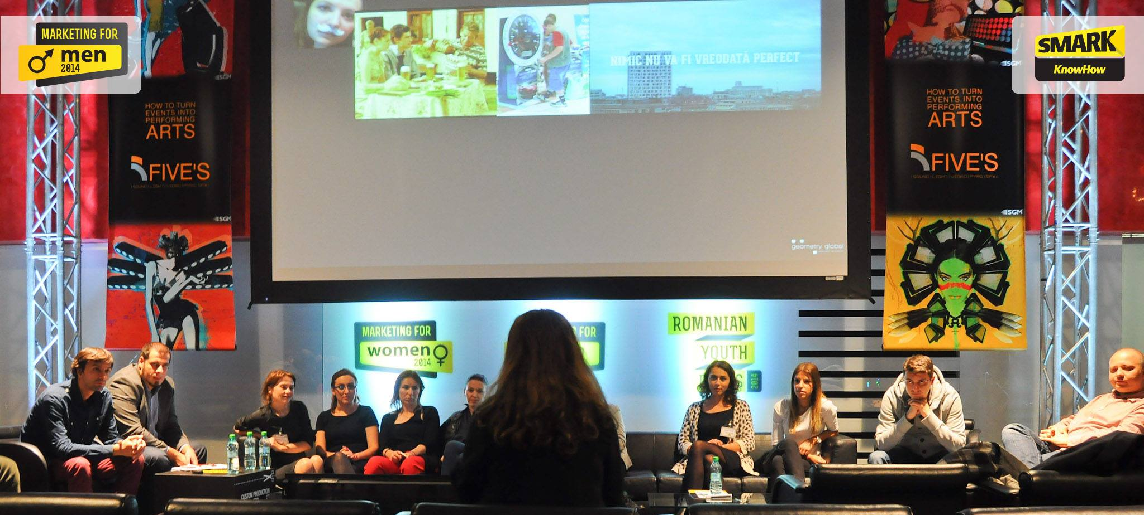
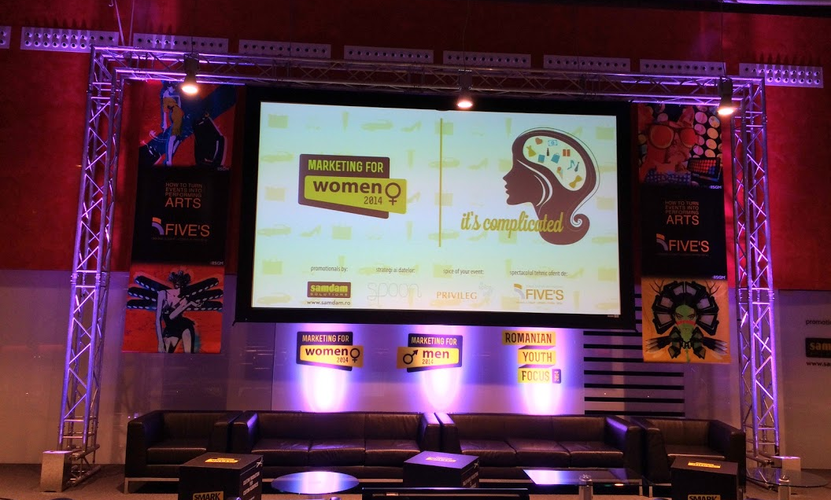
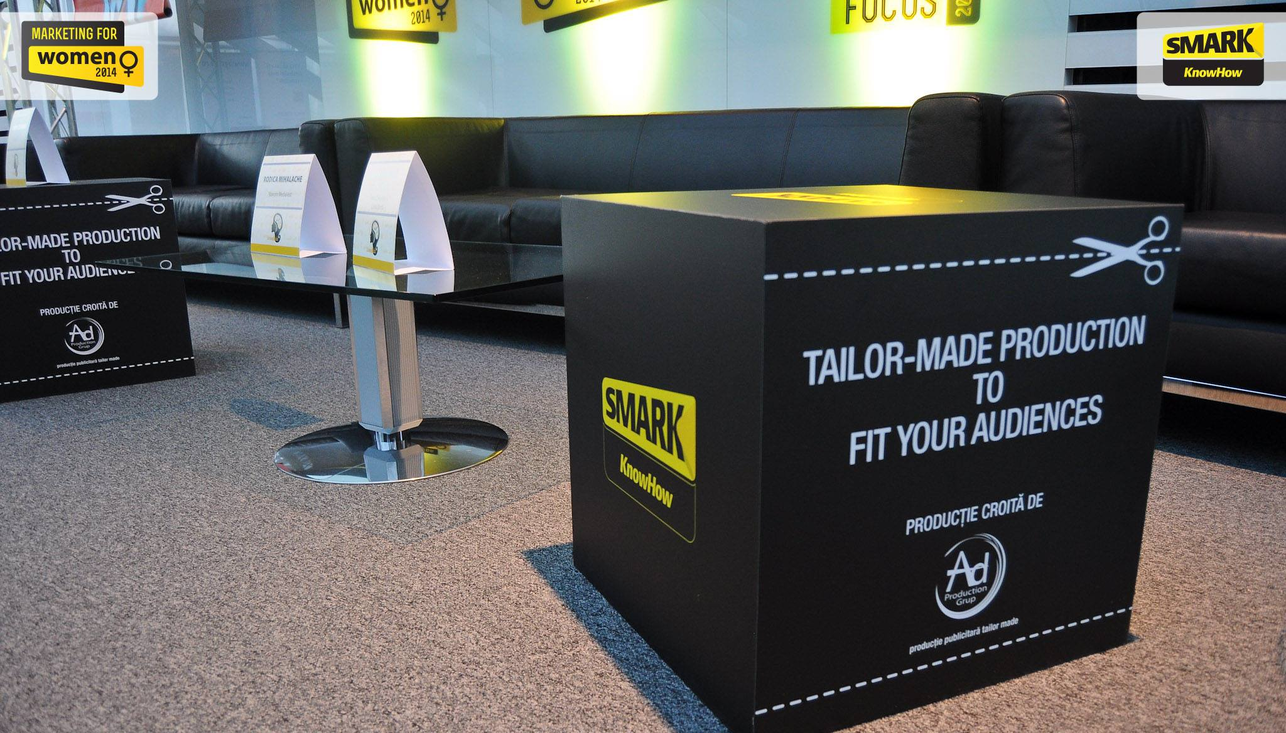
Examples: content inside the conference room
Client: Spoon: media agency upgraded to full service
Idea: we integrated a custom workshop by Spoon about the new channels relevant to youngsters
Client: FIVE’S: light, sound, pyro & SFX solutions
Idea: we upgraded the light & multimedia scheme, a demo for their solutions applied to our case
Client: AdProduction: advertising production brand
Idea: we used their tailor-made solutions to enhance our event

Slide 16
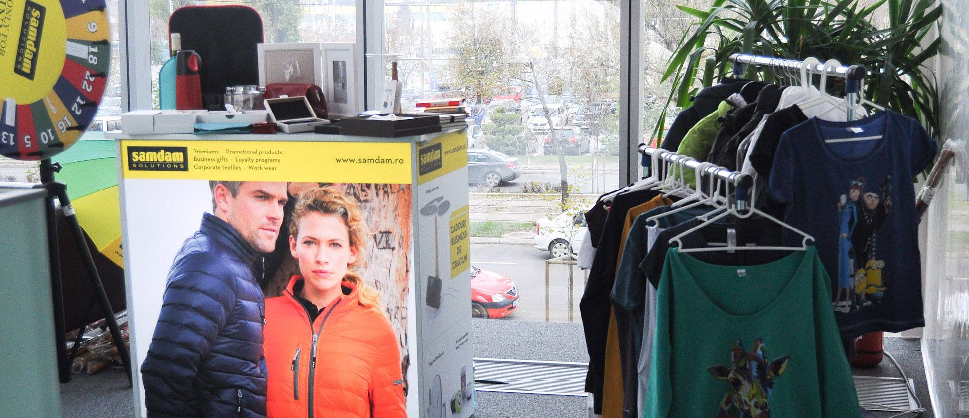
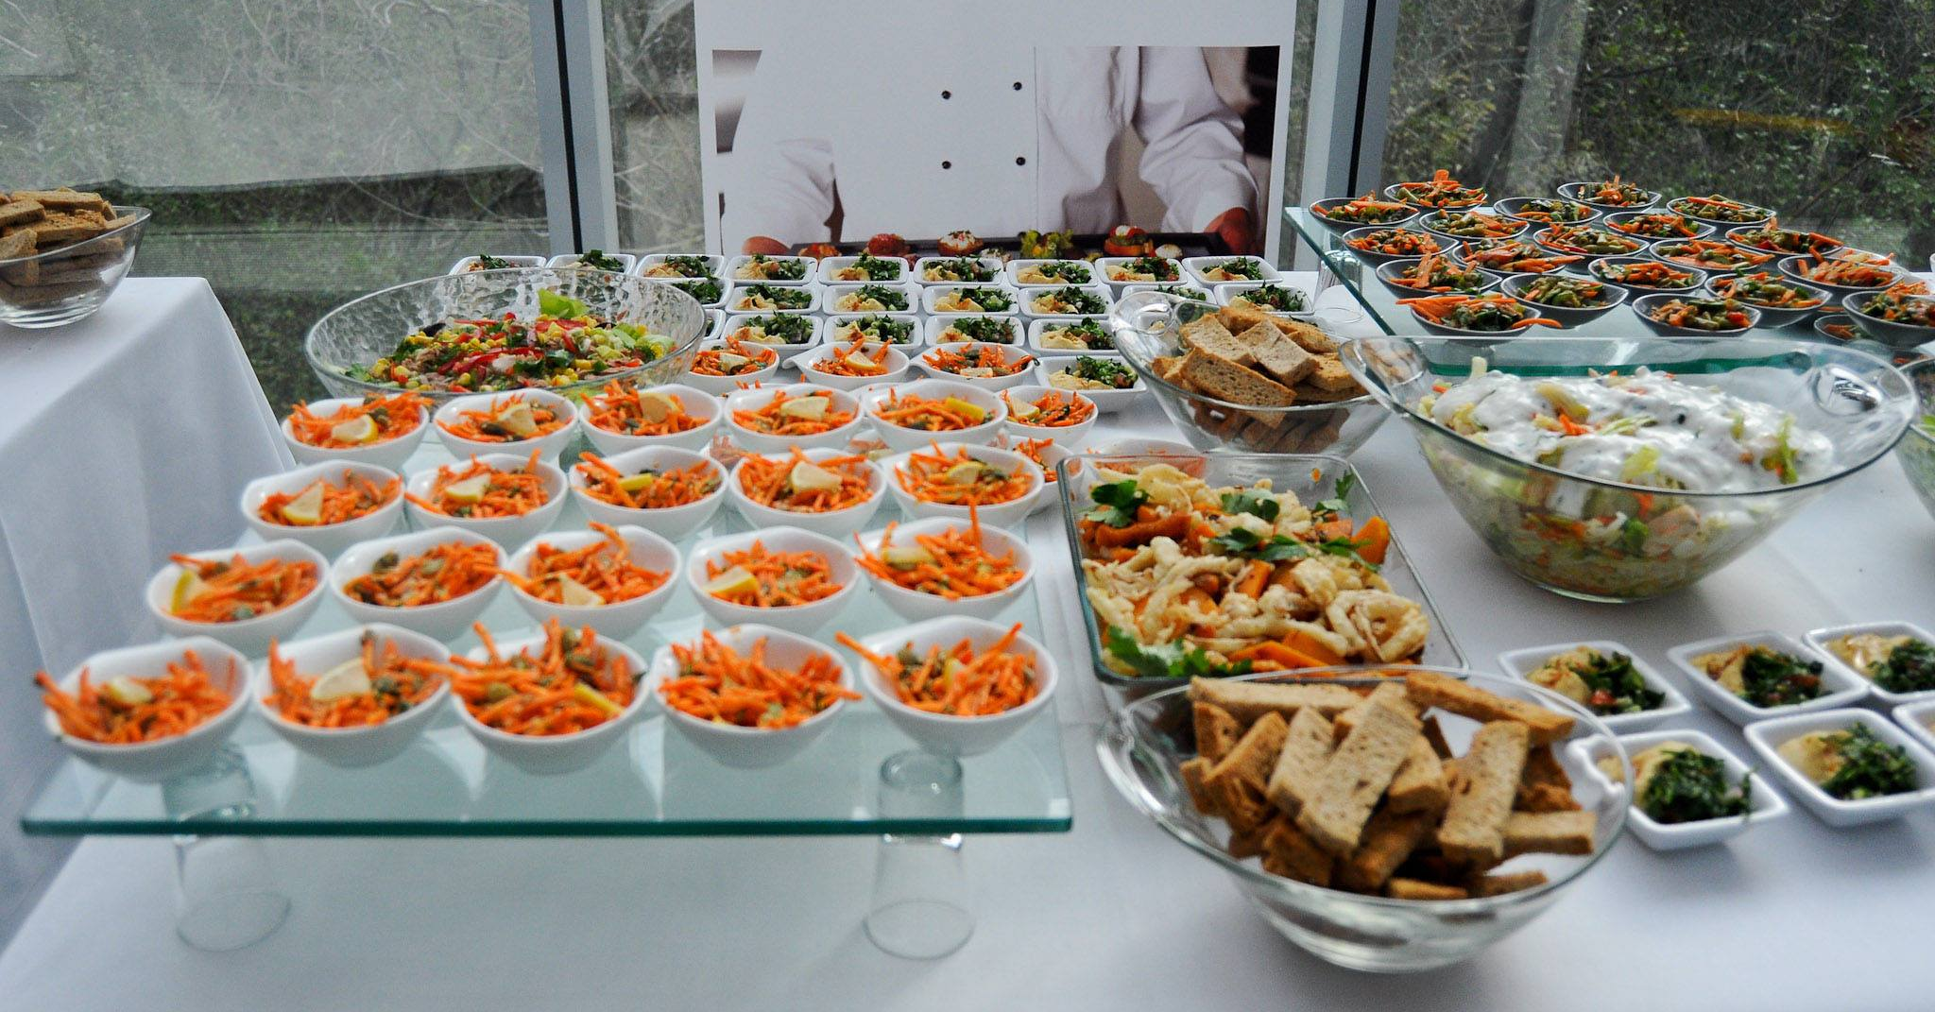
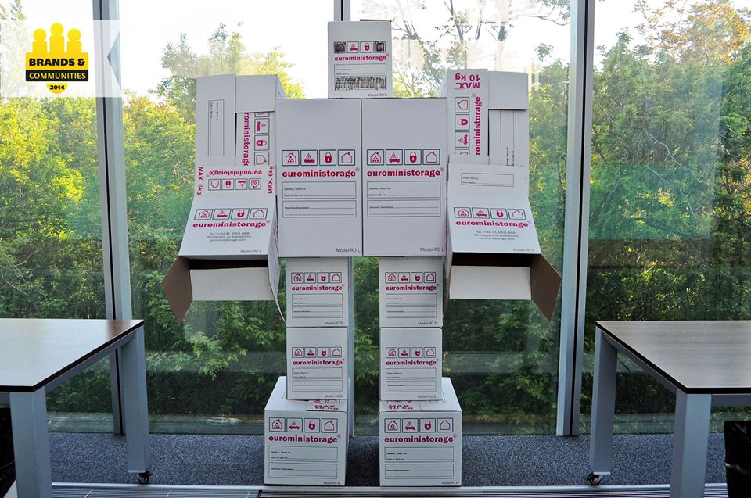
Examples: interactions in the lobby
Client: Samdam: leader of promotionals, textiles, premiums
Idea: we present their new collections regularly at our conferences, for everyone to try
Client: Privileg: premium catering provider
Idea: we bring themed food to each of our events, such as handmade burgers for youngsters
Client: EuroMiniStorage: personal locker providers
Idea: we demonstrated their brand message, Think inside the box, to our relevant audience

Slide 17
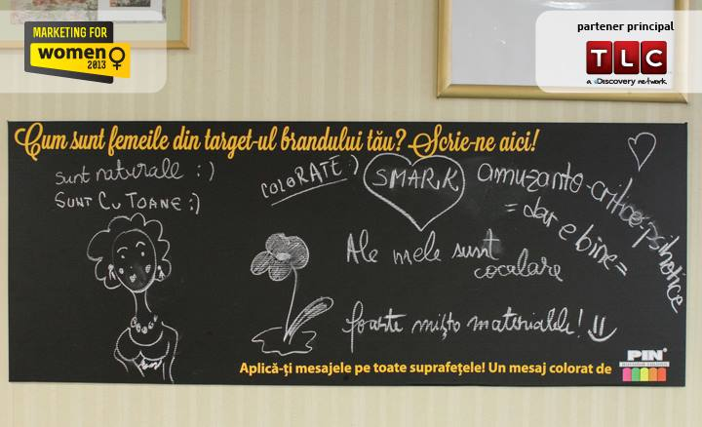
Examples: customized product placement
Client: PIN Group, importer of self adhesive materials
Idea: using their materials, we put on display messages on the event’s topic in key places: floor, mirrors, walls

Slide 18
Reach for your brand per event
Via event’s media campaign, featuring you:
Online: 150.000 people (via 400.000 banners, newsletters, branding...)
Radio: 50.000 people (via 10 day radio campaign)
Via social media:
100.000 people (via Facebook views, photo tagging, likes etc.) + PR, news, buzz
------------------
A total from which we deduct an intersection ratio of 33%: Total reach of your brand in association with the event: 200.000+ people - no crosses, in a 20-day promotional campaign 150 total participants per event
Media partners in 2014:

Slide 19
Budget
PER EVENT
A. Agency: 2.500 EUR
Reputation as partner of the event
Engagement via demos at the event
Networking with premium business participants
Promotion in the event’s campaign & PR
Extra benefits: advertorial, invitations
B. Client or Agency + Client: 3.500 EUR
Highest visibility as main supporter of the event
Access to the contacts of the participants and follow-up facilitation
Reputation as partner of the event
Engagement via demos at the event
Networking with premium business participants
Promotion in the event’s campaign & PR
Extra benefits: advertorial, invitations
PER SEVERAL EVENTS tbd
18, 19 February
13, 14 May
23, 24 September
11, 12, 13 November

Slide 20
First event of 2015
4th edition
18 – 19 March 2014
conference + workshop a complete look on promotions and contests: national consumer promotions to small scale, contests online and offline, from planning, creative and implementation to measurement.
see a short clip of Promotions Now 2013

Slide 21
2015
Media campaign: details

Slide 22
A.1. Shared campaign, before the event
Online banners, 400.000 impressions, dedicated slide for your brand on IQads.ro, SMARK.ro, audience retargeting via Facebook Ads, Google Ads, Cariereonline.ro, Revista-Piata.ro, IAA.ro, BestJobs.ro, HotNews.ro, RevistaBiz.ro, Business24.ro, Ziare.com, Realitatea.Net, Forbes, Wall Street, Port.ro, Magazin Progesiv / see example
Event website featuring your brand / see example
Newsletters dedicated to the event featuring your brand, 2 editions sent to IQads + SMARK: 20.000 + 5.000 active subscribers / see example
Facebook Cover of SMARK and IQads featuring your brand / see example
Premium editorial content announcing the conference on IQads and SMARK, 3 editorial materials: news, interviews, feature articles, reviews (at the end, a dedicated paragraph about your brand) / see example
Direct mailing sent to participants of previous editions and companies from IQads Catalogue, featuring your brand

Slide 23
A.2. Shared campaign, after the event
Dedicated newsletters featuring your brand, 2 editions sent to all active IQads + SMARK subscribers: 20.000 + 5.000 / see example
Branded header in the IQads and SMARK editorial newsletters sent to all active IQads + SMARK subscribers: 20.000 + 5.000 / see example
Premium editorial content reviewing the conference on IQads and SMARK, 3 editorial materials: news, interviews, follow-ups (at the end, a dedicated paragraph about your brand) / see example
Event’s photo album branded with your brand in the watermark / see example
Posts about the event on IQads and SMARK Facebook pages / see example

Slide 24
B.1. Dedicated promotion, during the event
Demonstration of the skills of your brand in a dedicated space in the event’s lobby via a relevant activation, created and implemented by your brand
A promotional video about your brand played during each break
Creative promotional materials in the folders given to the participants, supporting the activation or the role of your brand as partner / see example
Dedicated digital presentation of your brand in the post event kit, sent to all the participants / see example
Bonus: 3 invitations at the conference for your brand’s team or partners
Extra, only if relevant: keynote about your knowhow on the topic during the conference

Slide 25
B.2. Dedicated promotion, after the event
1 advertorial about your brand, featuring a story about it.
Published on a dedicated page which is intensively promoted 5 days after the publication on IQads & SMARK.
Examples:
SMARK.ro/advertorial/modelul_suedez_de_a_te_mentine_in_forma_introdus_si_in_romania
IQads.ro/advertorial/pop_up_your_mind_a_ajuns_in_cluj_provoked_by_grolsch
The advertorial is promoted:
In the right column of IQads and SMARK homepages
Through a link in 1 IQads editorial newsletter (20.000 active subscribers) and a link in 1 SMARK editorial newsletter (5.000 active subscribers)
Share on IQads (115.000+ fans) and on SMARK Facebook account (8.000+ fans)
1 post in the Jobs sections of IQads or SMARK - AdJob & MkJob the most efficient recruiting tool for the advertising and marketing industries in Romania.
3 premium subscriptions to the paid content of SMARK and IQads for 1 year, more on: www.SMARK.ro/SMS

Slide 26
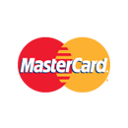
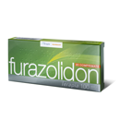
IQads & SMARK – major partners on bigger projects

Slide 27
SMARK – The Community of Marketing People
SMARK is a source of knowledge, a practical tool for professional development and networking for the people working in the Romanian marcomm industry
SMARK offers:
Premium editorial content, on SMARK.ro
Conferences and workshops on specific subjects, grouped as SMARK KnowHow
Syndicated research studies, grouped as SMARK Research
SMARK gathers a premium community of marketing and business people:
Brand Managers, Marketing Directors, Sales Managers
Consumer and market research professionals
Media specialists (including digital and social media)
Communication professionals (PR, CSR, advertising)
Entrepreneurs

Slide 28
IQads – The Community of Ad Pros and Aficionados
IQads is the most important Romanian platform devoted entirely to advertising and communication, gathering the most important creative community of Romania, with respected professionals, freelancers as well as mere admirers
IQads offers:
Daily multimedia content, news, interviews, analyses & more: IQads.ro
events and projects for the creative community, both online and offline: ADfel, The Creator UGC platform, Agencies' Football Cup, AdBreak, BestAds & more
IQads gathers a community of creatives, way beyond people working in advertising: artists, designers, movie makers, architects, students, freelancers etc.
IQads supports SMARK KnowHow events by publishing content about the series and hosting an important part of the promotional campaign for the events

Slide 29
Contact
MARIN PREDA
Business Developer IQads + SMARK
marin@iqads.ro
0727842813
IOANA DOGARU
Business Developer SMARK KnowHow
ioana@smark.ro
0722778994
18, 19 February
13, 14 May
23, 24 September
11, 12, 13 November

